Slide 1
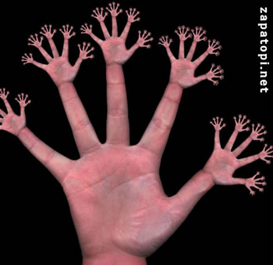
I Think, You Think, I Think, You’re Lying:
The Interactive Epistemology of Trust
Mihnea Moldoveanu and Joel Baum
Desautels Centre for Integrative Thinking
Rotman School of Management
University of Toronto
Copyright 2010 Mihnea Moldoveanu

Slide 2
VP of Business Development
VP of Marketing
VP of Engineering
Chief Operating Officer
CEO
Chairman
B1
B3
B2
Copyright 2010 Mihnea Moldoveanu

Slide 3
VP of Business Development
VP of Marketing
VP of Engineering
Chief Operating Officer
CEO
Chairman
B1
B3
B2
Copyright 2010 Mihnea Moldoveanu

Slide 4
VP of Business Development
VP of Marketing
VP of Engineering
Chief Operating Officer
CEO
Chairman
T1
B1
B3
B2
Copyright 2010 Mihnea Moldoveanu

Slide 5
VP of Business Development
VP of Marketing
VP of Engineering
Chief Operating Officer
CEO
T3
Chairman
B1
B3
B2
TO: 12pm Day 1
TO
Copyright 2010 Mihnea Moldoveanu

Slide 6
VP of Business Development
VP of Marketing
VP of Engineering
Chief Operating Officer
CEO
Chairman
T1
B1
T1
B3
B2
TO: 12pm Day 1
T1: 4:45pm Day 2
TO
Copyright 2010 Mihnea Moldoveanu

Slide 7
VP of Business Development
VP of Marketing
T2
VP of Engineering
Chief Operating Officer
CEO
Chairman
T1
T1
B1
B3
B2
TO: 12pm Day 1
T1: 4:45pm Day 2
T2: 8am Day 2
TO
Copyright 2010 Mihnea Moldoveanu

Slide 8
VP of Business Development
VP of Marketing
T2
VP of Engineering
Chief Operating Officer
CEO
T3
Chairman
T1
T1
B1
B3
B2
TO: 12pm Day 1
T1: 4:45pm Day 2
T2: 8am Day 2
TO
T3: 12pm Day 2
Copyright 2010 Mihnea Moldoveanu

Slide 9
VP of Business Development
VP of Marketing
T4
T2
VP of Engineering
Chief Operating Officer
CEO
T3
Chairman
T1
T1
B1
B3
B2
TO: 12pm Day 1
T1: 4:45pm Day 2
T2: 8am Day 2
TO
T3: 12pm Day 2
T4: 5pm Day 2
Copyright 2010 Mihnea Moldoveanu

Slide 10
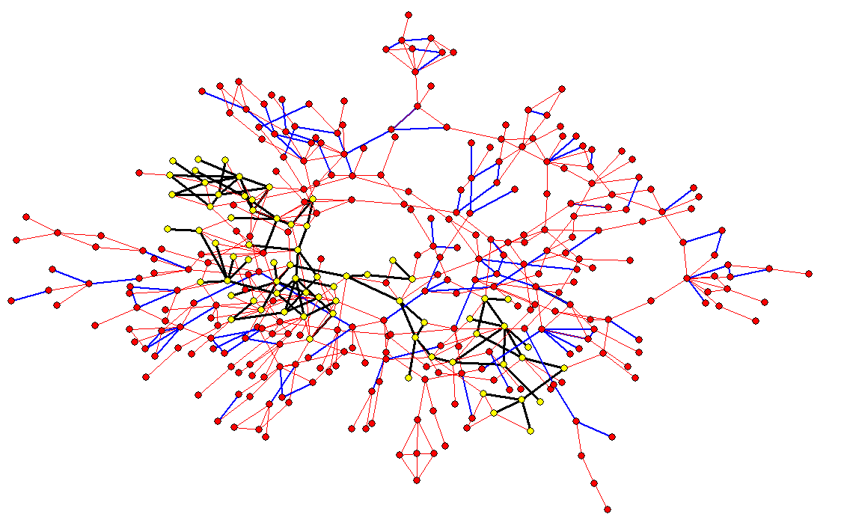
Organizational Spectroscopy: Trust Networks at a Major Telecommunications Service Provider
Red dots: individuals;
Pink lines: relationship/friendship ties;
Blue lines: trust ties;
Yellow dots and Black lines: fully connected component of trust network.

Slide 11
What we are after...
A precise characterization of trust in terms of individuals ‘epistemic states’ (beliefs, meta-beliefs, etc.), that helps us...
Represent trust conduits and corridors and ‘superconductive networks’, which...
Help us study and understand the ‘inner life’ of interpersonal/inter-organizational networks via...
Careful empirical studies aimed at uncovering the structure and causal relevance of trust and the dynamics of information and coordination.

Slide 12
‘Trust’: Brief Excursus on Semantics
Trust alternatively and variously defined as:
[Dispositional] Proclivity to cooperate in prisoner’s dilemma game (Lewis and Weigert, 1985) or in the presence of the opportunity for opportunism [Gulati, 1995];
2. [Relational]. Coherent mutual expectations of cooperation on moral/ethical grounds (Barber, 1985);
3. [Mixed]. Coherent mutual expectations of rational cooperation [Friedland, 1990].
Our Goal: To ‘dissect’ the interactive sub-structures of trust.

Slide 13
I. Definitions: Trust in Competence
A k
(PєT
→ BkP)
“P is true”
(and relevant)
“B knows P”
A knows that if P is true then B knows P
In this case “A trusts in B’s competence (AT_{c} B)
Copyright 2010 Mihnea Moldoveanu

Slide 14
Trust in Competence: Example
P = “Day 85 revenue = $15MM / Quarterly target of $22MM”
CEO knows
(PєT
→ VP Sales knows P), so:
CEO trusts in the competence of the VP of sales vis a vis P
Copyright 2010 Mihnea Moldoveanu

Slide 15
2. Definitions: Trust in Integrity
A k
(BkP
→ BaP)
A knows that if
B know P then
B will assert P
“B knows P”
“B asserts P”
In this case, A trusts in the integrity of B, or AT_{I} B
Copyright 2010 Mihnea Moldoveanu

Slide 16
3. Trust Tout Court
AT_{c} B & AT_{I} B → ATB
What this means is:
P is true
B knows P
A knows this
&
A knows this too
B asserts P
Copyright 2010 Mihnea Moldoveanu

Slide 17
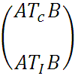
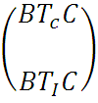
4. Definitions: Trust Conduit
Suppose
A trusts B & B trusts C
&
&
Question: Will A trust C?
Copyright 2010 Mihnea Moldoveanu

Slide 18
Yes, because:
B k
[PєT
→ CkP
→CaP]
Q
A k
[QєT
→ BkQ
→BaQ]
Copyright 2010 Mihnea Moldoveanu

Slide 19
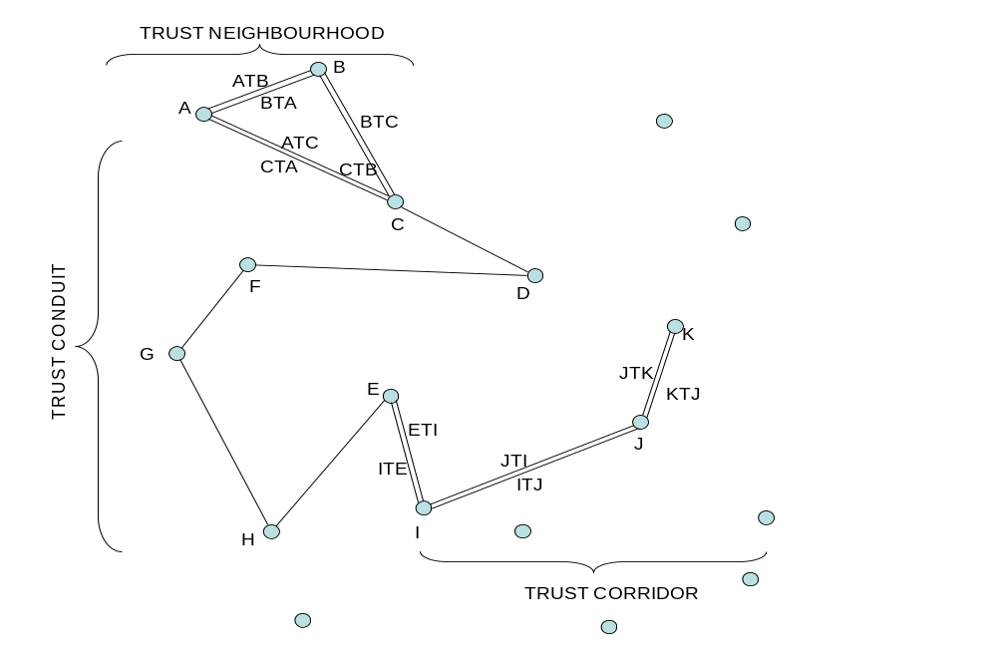
Mapping ‘Superconductive Networks’

Slide 21
What are the P’s and Q’s that ‘matter’ in a network?
Consider focal beliefs, eg:
I think that you will mobilize if I do;
You think I will mobilize if you do;
So: if I know that “You think I will mobilize if you do” and,
you know that “I think that you will mobilize if I do”,
THEN: We will mobilize.
OR,
I think ‘let’s meet in Harvard Square’ means ‘let’s meet by T stop’
You think ‘let’s meet in Harvard Square’ means ‘let’s meet by T stop’
I think you think ‘let’s meet in Harvard Square’ means ‘let’s meet by T stop’
You think I think ‘let’s meet in Harvard Square’ means ‘let’s meet by T stop’
I think you think I think ‘let’s meet in Harvard Square’ means ‘let’s meet by T stop’
You think I think you think’ ‘let’s meet in Harvard Square’ means ‘let’s meet by T stop’
THEN:
We shall likely meet (by the T stop).

Slide 22
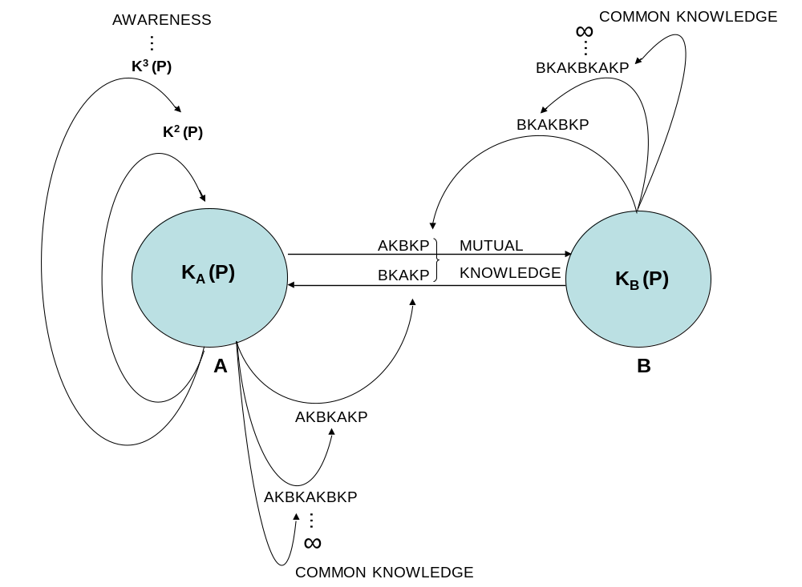
It is useful to have a precise representation of the epistemic states of agents in a network:

Slide 23
EXAMPLE: Interactive Epistemology of Cournot-Nash Equilibrium Selection in a Duopoly
Firm 1’s quantity choice/best response
Firm 2’s quantity choice/best response
a-c
2
a-c
2
Best Response
a-c
4
a-c
4
Generate using series
q_{N}= a-c - q_{N}-1 ;
2 2
q_{o}=0
Which results from joint maximization of profits
Π_{i} = (a-c-q_{i}-q_{j})q_{i}
Best Response
So, if firm 1 says, “I will sell a-c , firm 2 will
2
credibly retort, “I will sell a-c “; which would
4
Lead to losses relative to the a-c , a-c
3 3
solution
3(a-c)
8
3(a-c)
8
Best Response
5(a-c)
16
5(a-c)
16
Best Response
11(a-c)
32
11(a-c)
32
…
…
a-c
3
NASH EQUILIBRIUM

Slide 24
Unpacking Interactive Epistemic States: More Easily Done Than Said
Knows³
Knows²: A knows B knows P
B knows A knows P
Knows²
A
B
Knows³: A knows B knows A knows P
B knows A knows B knows P
Knows²
Knows
Knows³
Knows
P
Copyright 2010 Mihnea Moldoveanu

Slide 25
Exploratory Study 1: “Coordination among coordinators”
Subjects:11 members of department in a business school, polled by anonymous
questionnaire on a set of 5 issues of immediate and common interest
via 3 sets of questions aimed at uncovering:
Do you know believe P?
Do you know/believe that Alter knows/believes P ?
Do you believe that alter believes/knows that you know/believe P?
… as well as a set of questions aimed at identifying:
Interaction sub-networks (‘I interact with alter with at least frequency F’);
Collaboration sub-networks (‘I collaborate/d with alter on at least Q projects
during past M months’);
C. Friendship sub-networks (‘I agree/disagree with ‘alter is my friend’ to level L’)

Slide 26
Exploratory Study 1 (continued)
Answers are then compared to compute ‘degrees of epistemic coherence’ between:
1. what ego thinks alter thinks and what alter thinks (level 2);
2. what alter thinks ego thinks and what ego thinks alter thinks ego thinks
(level 3)
which are then correlated with:
I. Centrality (betweenness, degree, eigenvector) measures for ego and alter
in friendship, interaction, collaboration networks;
II. Apartenence of ego and alter to the same clique.
... to find:

Slide 27
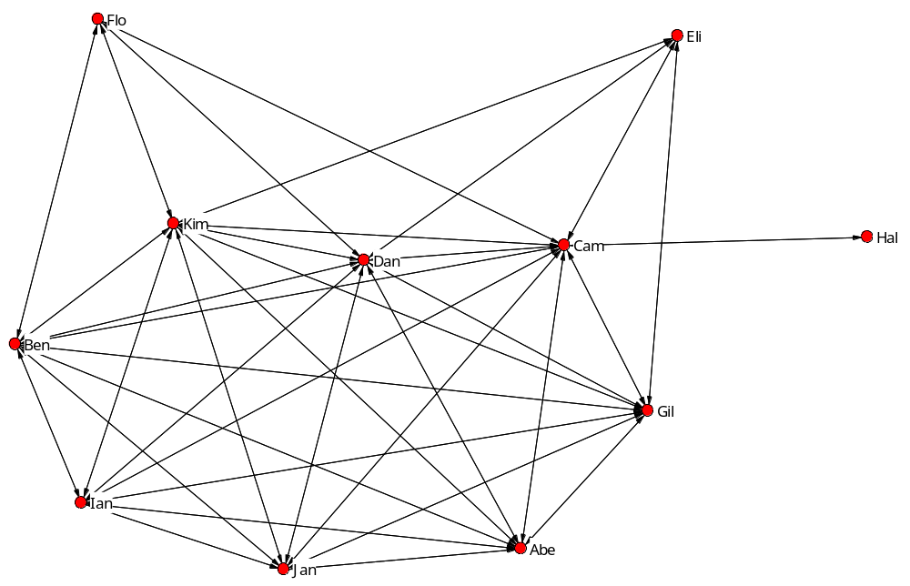
Level-2 epistemic network for issue (a)

Slide 28
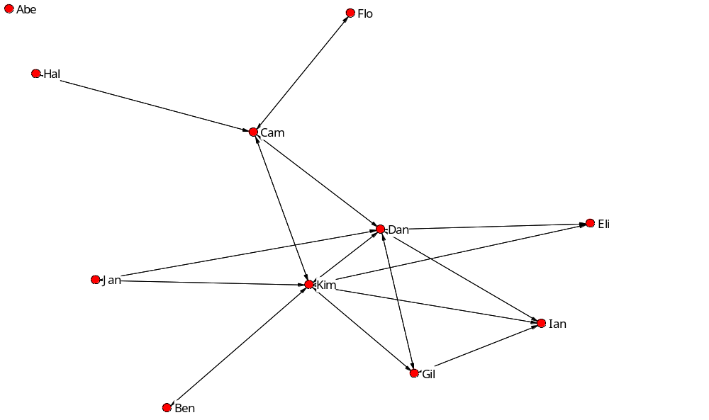
Level 3 Epistemic Network for Issue (a)

Slide 29
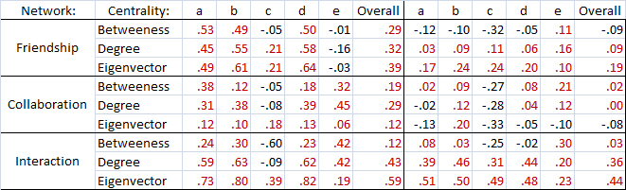
Correlation of level 2,3 knowledge with centrality
Some centrality measures are good predictors of level 2 epistemic states,
but relatively poorer predictors of level-3 epistemic states.

Slide 30
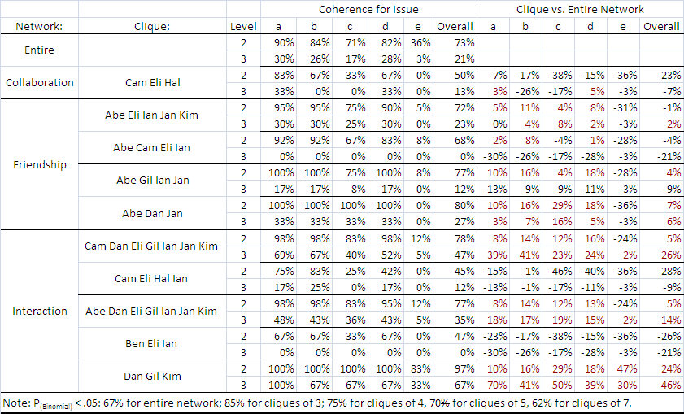
Correlation of epistemic coherence with cliques

Slide 31
Exploratory Study 2. Trust and “Coordinatability “
Subjects: 593 D,V-level managers of major telecommunications service provider,
upon completion of executive development program, polled on (1) their own
network of relationships within the firm, (2) their degree of trust in each member of the network, (3) their beliefs and beliefs about alters’ beliefs (etc) about key
leading performance drivers (defined in the seminars). [302 survey responses received, 293 useable for the analysis, 113 reciprocated relationships].
Relevant questions:
[Level 1]What do you believe to be key performance driver for the firm?
[Level 2]What do you believe alter believes to be key performance driver for the firm?
[Level 3] Does alter know what you believe to be ...?
[Level 4] Does alter believe he/she knows what you believe alter believes to be ....?
… as well as a set of questions aimed at identifying:
Geographic co-location of ego and alter;
Functional co-location of ego and alter;

Slide 32
Organizational Spectroscopy: Trust Networks at a Major Telecommunications Service Provider
Red dots: individuals;
Pink lines: relationship/friendship ties;
Blue lines: trust ties;
Yellow dots and Black lines: fully connected component of trust network.

Slide 33
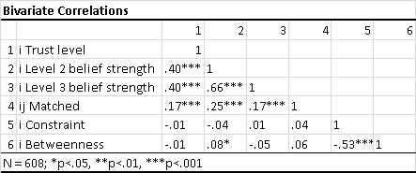
Preliminary Results, Exploratory Study 2.
Bivariate Correlations, all relationships: Level 2 (‘matched’), level 3 (2) and
level 4 belief strength positively and significantly correlated with trust, weakly
correlated with constraint and betweenness centrality, N=608 relationships.

Slide 34
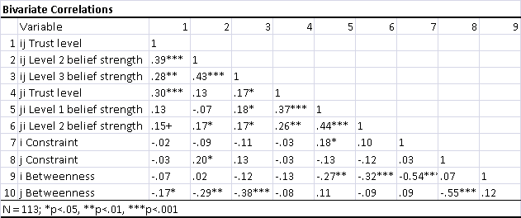
Preliminary Results, Exploratory Study 2.
2. Bivariate Correlations, reciprocated relationships: Level 2 (1),
level 3 (2), level 4 (3) belief strength, alter-ego trust positively and significantly
correlated with ego-alter trust.

Slide 35
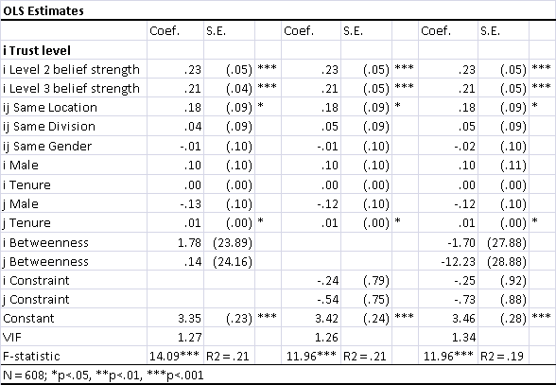
Preliminary results, Exploratory Study 2.
3. OLS Regression of Trust on level 2(3), level 3(4) belief strength, all N:
Level 2(3), 3(4) belief strength coefficients in predictor equation positive and
significant.

Slide 36
Preliminary results, Exploratory Study 2.
Findings for reciprocated relationships (N=113):
1. Ego-alter trust good predictor of alter-ego trust;
2. Trust

Slide 37
Speculative Coda: Unfolding Trust
Trust seems to be important to mobilization and coordination in networks,
in ways related to its logical structure (trust in competence/trust in integrity) and
the epistemic conditions for mobilization and coordination;
It seems cliche that ‘you need trust to coordinate’, but this is not self-evidently
true if we consider both trust in integrity and trust in competence;
We need to unpack trust empirically in order to discern between concerns related
to integrity and concerns related to competence;
4. We can use ‘interactive belief questionnaires’ to obtain trust measures that are
Independent from the use of the word ‘trust’; and,
5. We can use ‘epistemic mining’ to arrive at a ‘spectroscopic’ approach to the
Propagation of information/rumor

